Slide 1
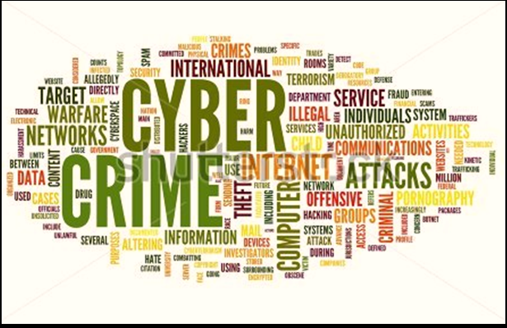

Slide 2

Outline
ABSTRACT
INTRODUCTION
DEFINITION
CYBER CRIME VARIANT
INDIA CRIME SCENE
CYBER LAW IN INDIA
PREVENTION

Slide 3
The title of the term paper is ‘CYBER CRIME AND SECURITY’. This project is based on the growing crime cases online in cyber space and the security measure needed to minimize the risk of CYBER attack. This project has done under the guidance of Dr. Pinkey Chauhan in 8 weeks.
This presentation includes a brief description on Cybercrime , its different variant , cybercrime in INDIA , various laws governing in the field of cybercrime , precaution must be taken to make use of internet safer and convenient , conclusion etc. The project aims to make the presentation simple and easy to understand about the crimes on cyber space and the precaution that must be carried out and laws related to that field which they have to carry in their mind and work accordingly.
Abstract

Slide 4
Crimes are not to be measured by the issue of events, but by the bad intensions of men.
The greatest crimes do not arise from a want of feeling for others but from an over sensibility for ourselves and an over indulgence in our own desires
Introdution

Slide 5

CYBER CRIME !!
The expression ‘Crime’ is defined as an act, which subjects the doer to legal punishment or any offence against morality, social order or any unjust or shameful act. The “Offence" is defined in the Code of Criminal Procedure to mean as an act or omission made punishable by any law for the time being in force.
Cyber Crime is emerging as a serious threat. World wide governments, police departments and intelligence units have started to react.
DEFINiTION

Slide 6
Cyber Crime is a term used to broadly describe criminal activity in which computers or computer networks are a tool, a target, or a place of criminal activity and include everything from electronic cracking to denial of service attacks. It is also used to include traditional crimes in which computers or networks are used to enable the illicit activity.
Computer crime mainly consists of unauthorized access to computer systems data alteration, data destruction, theft of intellectual property. Cyber crime in the context of national security may involve hacking, traditional espionage, or information warfare and related activities.
Pornography, Threatening Email, Assuming someone's Identity, Sexual Harassment, Defamation, Spam and Phishing are some examples where computers are used to commit crime, whereas Viruses, Worms and Industrial Espionage, Software Piracy and Hacking are examples where computers become target of crime.

Slide 7

Cyber Crime Variants
Hacking
"Hacking" is a crime, which entails cracking systems and gaining unauthorized access to the data stored in them. Hacking had witnessed a 37 per cent increase this year.
Cyber Squatting
Cyber Squatting is the act of registering a famous Domain Name and then selling it for a fortune. This is an issue that has not been tackled in IT ACT 2000.

Slide 8

Phishing is just one of the many frauds on the Internet, trying to fool people into parting with their money. Phishing refers to the receipt of unsolicited emails by customers of Financial Institutions, requesting them to enter their Username, Password or other personal information to access their Account for some reason.
The fraudster then has access to the customer's online bank account and to the funds contained in that account.

Slide 9

Cyber Stalking is use of the Internet or other electronic means to stalk someone. This term is used interchangeably with online harassment and online abuse. Stalking generally involves harassing or threatening behaviour that an individual engages in repeatedly, such as following a person, appearing at a person's home or place of business, making harassing phone calls, leaving written messages or objects, or vandalizing a person's property.

Slide 10

VISHING
Vishing is the criminal practice of using social engineering and Voice over IP (VoIP) to gain access to private personal and financial information from the public for the purpose of financial reward. The term is a combination of “Voice" and phishing. Vishing exploits the public's trust in landline telephone services.
Vishing is typically used to steal credit card numbers or other information used in identity theft schemes from individuals.

Slide 11
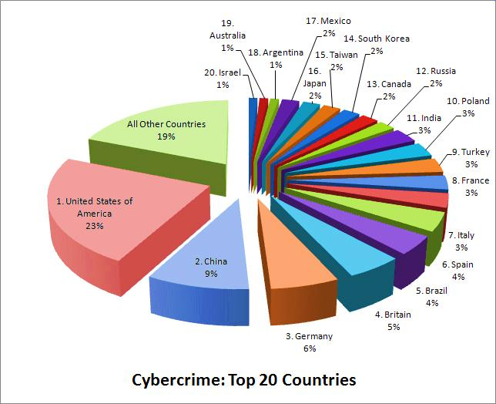
India stands 11th in the ranking for Cyber Crime in the World, constituting 3% of the Global Cyber Crime.

Slide 12

Indian Crime Scene
The major Cyber Crimes reported, in India, are Denial of Services, Defacement of Websites, Spam, Computer Virus and Worms, Pornography, Cyber Squatting, Cyber Stalking and Phishing.
Given the fact that nearly $ 120 million worth of Mobiles are being lost or stolen in the country every year, the users have to protect Information, Contact details and Telephone numbers as these could be misused. Nearly 69 per cent of information theft is carried out by current and ex-employees and 31 per cent by hackers. India has to go a long way in protecting the vital information.
[3 The Hindu, Saturday, Oct 27, 2007].

Slide 13

Why India?
A rapidly growing online user base
121 Million Internet Users
65 Million Active Internet Users, up by 28% from 51 million in 2010
50 Million users shop online on Ecommerce and Online Shopping Sites
46+ Million Social Network Users
346 million mobile users had subscribed to Data Packages.
Source: IAMAI; Juxt; wearesocial

Slide 14

Cyber Crime In India
The majority of cybercrimes are centered on forgery, fraud and Phishing,
India is the third-most targeted country for Phishing attacks after the US and the UK,
Social networks as well as ecommerce sites are major targets,
6.9 million bot-infected systems in 2010,
14,348 website defacements in 2010,
6,850 .in and 4,150 .com domains were defaced during 2011,
15,000 sites hacked in 2011,
India is the number 1 country in the world for generating spam.

Slide 15

Cost Of Cyber Crime In India (2010)
  29.9 million people fell victim to cybercrime,
  $4 billion in direct financial losses,
  $3.6 billion in time spent resolving the crime,
  4 in 5 online adults (80%) have been a victim of Cybercrime,
  17% of adults online have experienced cybercrime on their mobile phone.
  Source: Norton Cybercrime Report 2011

Slide 16
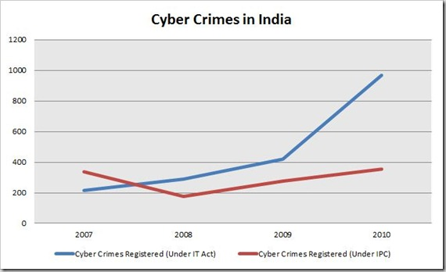
We have covered about three instances where high-profile government websites were hacked and defaced. However, the actual number of Government Websites that were hacked are quite huge.
A total number of 90, 119, 252 and 219 Government websites tracked by the Indian Computer Emergency Response Team (CERT-In) were hacked / defaced by various hacker groups in the year 2008, 2009, 2010 and Jan–Oct 2011 respectively.

Slide 17
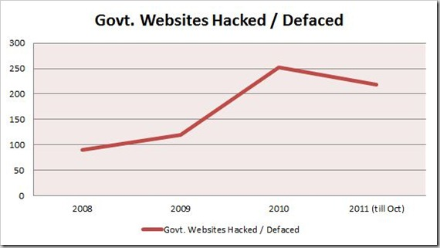
Again, this is growing trend and it is surprising that authorities have
not taken stern actions to curb the growth of these cyber-crimes.
The police have recorded 3,038 cases but made only 2,700 arrests in 3 years (between 2007 and 2010)
India registered only 1,350 cases under the IT Act and IPC in 2010
50% of cybercrimes are not even reported.

Slide 18

Cyber Laws in India
Under The Information
Technology Act, 2000
CHAPTER XI – OFFENCES – 66. Hacking with
computer system.
Whoever with the Intent to cause or knowing
that he is likely to cause Wrongful Loss or
Damage to the public or any person Destroys or
Deletes or Alters any Information Residing in a
Computer Resource or diminishes its value or
utility or affects it injuriously by any means,
commits hack.
(2) Whoever commits hacking shall be punished with imprisonment up to three years, or with fine which may extend up to two lakh rupees, or with both.

Slide 19
  Whoever without permission of
  the owner of the computer :
    Secures Access;
    Downloads, Copies or extracts
    any data, computer database or
    any information;
    Introduce or causes to be introduce
    any Virus or Contaminant;
    Disrupts or causes disruption;
    Denies or causes denial of access to any person;
    Provides any assistance to any person to facilitate access
    Charges the services availed of by a person to the account of another person by Tampering with or Manipulating any Computer, Computer System, or Computer Network;
    Shall be liable to pay damages by way of compensation not exceeding one crore rupees to the person so affected.

Slide 20
Information Technology Amendment Act, 2008
Section – 43,
Destroys, Deletes or Alters any Information residing in a computer resource or diminishes its value or utility or affects it injuriously by any means;
Steals, conceals, destroys or alters or causes any person to steal, conceal, destroy or alter any computer source code used for a computer resource with an intention to cause damage;
“If any person, dishonestly, or fraudulently, does any act referred to in section 43, he shall be punishable with imprisonment for a term which may extend to two three years or with fine which may extend to five lakh rupees or with both.” [S.66]

Slide 21
S.66A - Punishment for sending offensive messages through communication service, etc
Any person who sends, by means of a computer resource or a communication device;
Any information that is grossly offensive or has menacing character; or
Any information which he knows to be false, but for the purpose of causing annoyance, inconvenience, danger, obstruction, insult, injury, criminal intimidation, enmity, hatred, or ill will, persistently makes by making use of such computer resource or a communication device;
Any electronic mail or electronic mail message for the purpose of causing annoyance or inconvenience or to deceive or to mislead the addressee or recipient about the origin of such messages;
Shall be punishable with imprisonment for a term which may extend to three years and with fine.

Slide 22
S. 66C - Punishment for identity theft
“Whoever, fraudulently or dishonestly make use of the electronic signature, password or any other unique identification feature of any other person, shall be punished with imprisonment of either description for a term which may extend to three years and shall also be liable to fine which may extend to rupees one lakh”
S. 66D - Punishment for cheating by personation by using computer resource
“Whoever, by means of any communication device or computer resource cheats by personation, shall be punished with imprisonment of either description for a term which may extend to three years and shall also be liable to fine which may extend to one lakh rupees. “

Slide 23
S. 66E - Punishment for violation of privacy.
“Whoever, intentionally or knowingly captures, publishes or transmits the image of a private area of any person without his or her consent, under circumstances violating the privacy of that person, shall be punished with imprisonment which may extend to three years or with fine not exceeding two lakh rupees, or with both”
S. 67 A - Punishment for publishing or transmitting of material containing sexually explicit act, etc. in electronic form
“Whoever publishes or transmits or causes to be published or transmitted in the electronic form any material which contains sexually explicit act or conduct shall be punished on first conviction with imprisonment of either description for a term which may extend to five years and with fine which may extend to ten lakh rupees”

Slide 24
S. 67 C - Preservation and Retention of information by intermediaries.
“(1) Intermediary shall preserve and retain such information as may be specified for such duration and in such manner and format as the Central Government may prescribe.
(2) Any intermediary who intentionally or knowingly contravenes the provisions of sub section (1) shall be punished with an imprisonment for a term which may extend to three years and shall also be liable to fine.”

Slide 25

Arrests & Reports Under IT Act
Under the IT Act, 966 cybercrime cases were filed in 2012
420 in 2011)
Geographic breakdown of cases reported:
  153 from Karnataka,
  148 from Kerala
  142 from Maharashtra
  105 Andhra Pradesh
  52 Rajasthan
  52 Punjab
233 persons were arrested in 2010
33% of the cases registered were related to hacking
Source: National Crime Records Bureau

Slide 26

Arrests & Reports Under IPC
Under the IPC, 356 cybercrime cases were registered in 2012 (276 cases in 2011)
Geographic breakdown of cases reported --
  104 from Maharashtra
  66 Andhra Pradesh
  46 Chhattisgarh
The majority of these crimes were either forgery or fraud cases.
Source: National Crime Records Bureau

Slide 27
How to Tackle Such Activities?
An important question arises that how can these crimes be prevented. A number of techniques and solutions have been presented but the problems still exists and are increasing day by day.
Antivirus And Anti Spyware Software:
Antivirus software consists of computer programs that attempt to identify, thwart and eliminate computer viruses and other malicious software. Anti spy wares are used to restrict backdoor program, Trojans and other spy wares to be installed on the computer.
Firewalls:
A firewall protects a computer network from unauthorized access. Network firewalls may be hardware devices, software programs, or a combination of the two. A network firewall typically guards an internal computer network against malicious access from outside the network.

Slide 28
Cryptography:
Cryptography is the science of encrypting and decrypting information. Encryption is like sending a postal mail to another party with a lock code on the envelope which is known only to the sender and the recipient. A number of cryptographic methods have been developed and some of them are still not cracked.
Cyber Ethics and Laws:
Cyber ethics and cyber laws are also being formulated to stop cyber crimes. It is a responsibility of every individual to follow cyber ethics and cyber laws so that the increasing cyber crimes shall reduce. Security Software like Anti Viruses and Anti Spy Wares should be installed on all computers, in order to remain secure from Cyber Crimes. Internet Service Providers should also provide high level of security at their servers in order to keep their clients secure from all types of viruses and malicious programs.

Slide 29
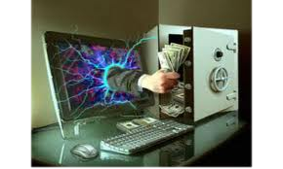

The Future of Cyber Crimes in India
Continued Website Hacks and Defacements
Data and Information theft
Increasing phishing attacks on Ecommerce and Financial Websites
Cybercriminals targeting Social and Professional Networks
Threats directed at the Mobile Platform: Smartphones and Tablets

Slide 30
Conclusion…
“Indian Laws are well drafted and are capable of handling all kinds of challenges as posed by cyber criminals. However, the enforcement agencies are required to be well versed with the changing technologies and Laws.”
"As internet technology advances so does the threat of cyber crime. In times like these we must protect ourselves from cyber crime. Anti-virus software, firewalls and security patches are just the beginning. Never open suspicious e-mails and only navigate to trusted sites.”

Slide 31
Still have a doubt ?
THANK YOU!!
ASET

