Slide 1
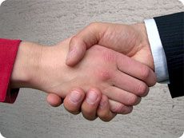
BUILDING RAPPORT

Slide 2
. Building rapport. is the feeling of 'being on the same wavelength' or 'in tune' with another person
Rapport building is the single most important aspect of communication .
All communication efforts can get futile if rapport with the team members is not good.

Slide 3
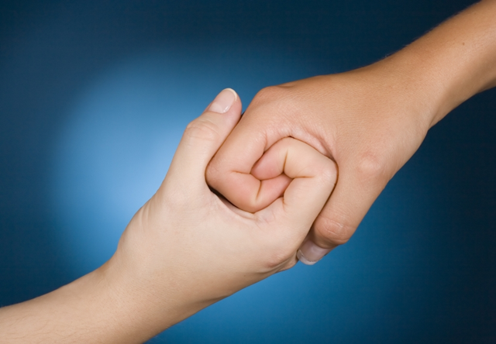
Building rapport is analogous to strengthening a bridge over a river: the stronger the bridge, the more it can carry.

Slide 4
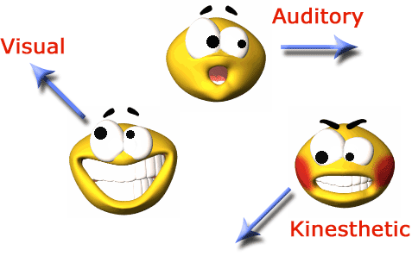
Rapport happens at many levels….
The places and people you spend time with
The way you look, sound, and behave
The skills you have learned
The values that you live by
Your beliefs
Your purpose in life

Slide 5
Ways to build rapport…
Take a genuine interest in getting to know what's important to the other person.
Pick up on the key words, favourite phrases and way of speaking that someone uses and build them subtly into your own conversation.
Notice how someone likes to handle information.
Look out for the other person's intention
Adopt a similar stance to them in terms of your body language, gestures, voice tone and speed.
Respect the other person's time, energy, favourite people and money.

Slide 6
How To Be More Assertive…
Use active listening skills to hear what they are saying.
Make empathetic statements, that demonstrate you understand their situation and needs.
Ask them questions about their views, or the problems they see, or the reservations they have.
Find things that you have in common and talk about them
Deale with them face to face and look them in the eye
Take an interest in the whole person, and their wider interests,.

Slide 7
Hence as said:- “A First impression is the Last impression.”
If you cannot communicate effectively, then you won’t be able to sell yourself to others or build rapport

